Slide 1

Internet Of Things Hands on Workshop
DAY 2

Slide 2



IoT Platforms
Blynk IoT
ThingSpeak API
Arduino IoT Cloud

Slide 3
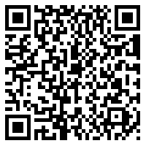
Access all Code (IoT Platforms)
shorturl.at/rvyR0

Slide 4
Arduino IoT Cloud
Arduino IoT Cloud is an application that helps makers build connected objects in a quick, easy and secure way. You can connect multiple devices to each other and allow them to exchange real-time data. You can also monitor them from anywhere using a simple user interface. Arduino has taken a step forward to keep IoT as simple and reachable as possible. Initially, IoT Cloud was available only to the Arduino Boards, but now, it even provides Web Sketches for other third-party boards like ESP8266 / 32, LoRaWAN as well.

Slide 5
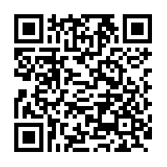
Arduino IoT Cloud
https://docs.arduino.cc/cloud/iot-cloud/tutorials/esp-32-cloud

Slide 6
What is an API?

Slide 7
Application Programming Interface
A RESTful API takes the REST architectural style and guides in interaction with RESTful web services. It defines a set of constraints, for how, the architecture of Web will behave.
Here, REST - Representational State Transfer
Referred to as a contract between an information provider and an information user — establishing the content required from the consumer (request) and the content required by the producer (response)

Slide 8
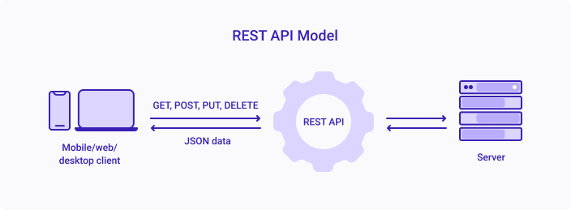
Application Programming Interface
HTTP Methods – GET, POST, PUT, HEAD, DELETE, PATCH, OPTIONS Status Codes – 1xx, 2xx, 3xx, 4xx, 5xx

Slide 9
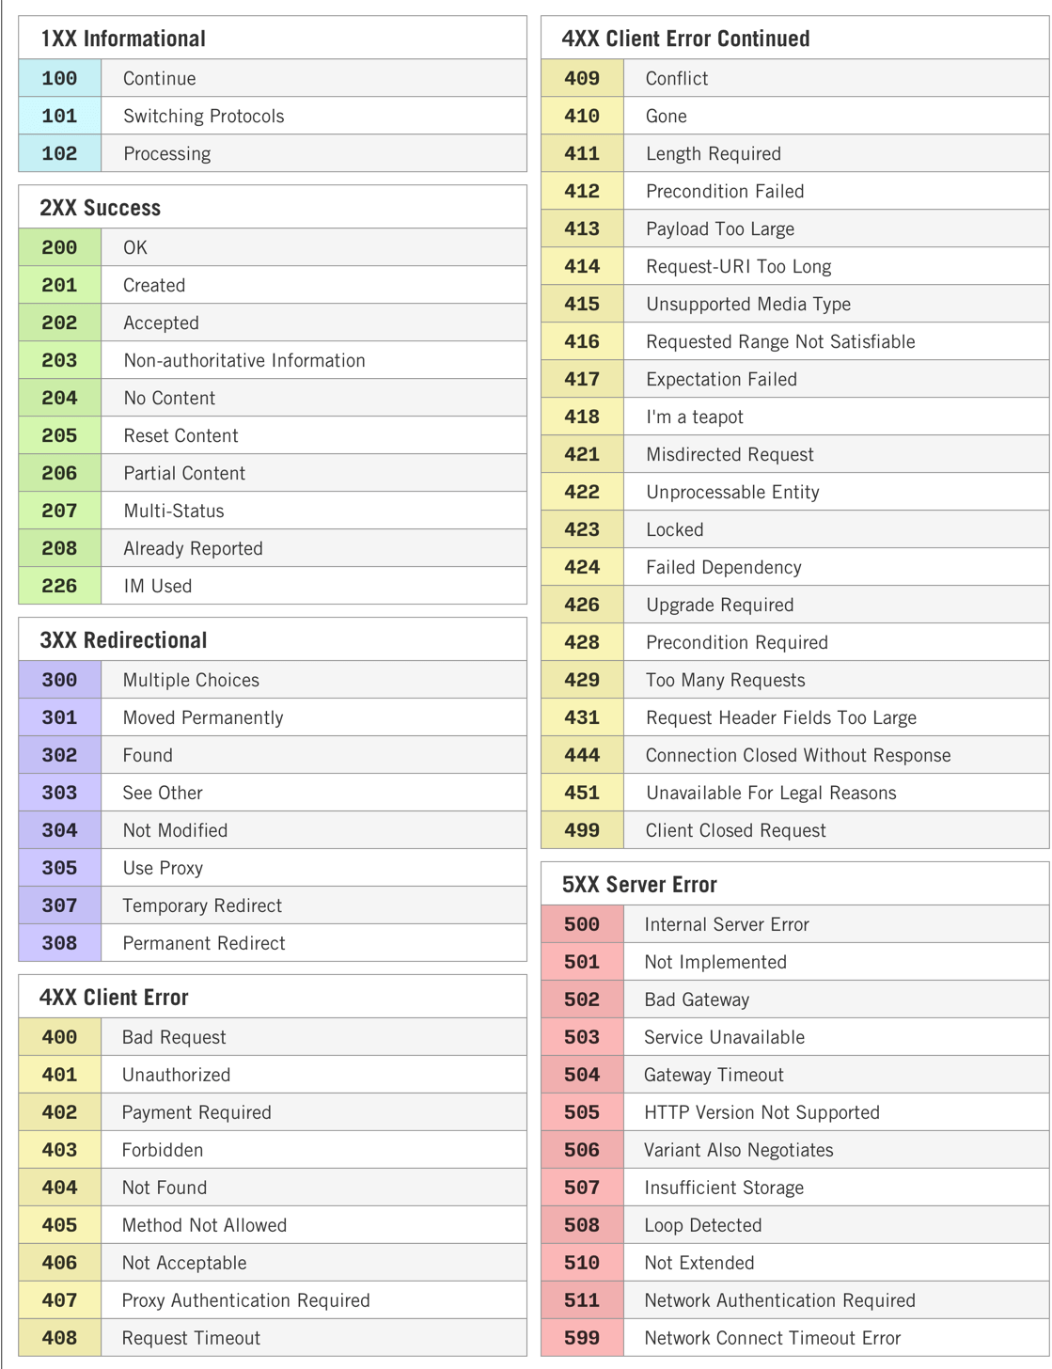
Application Programming Interface

Slide 10
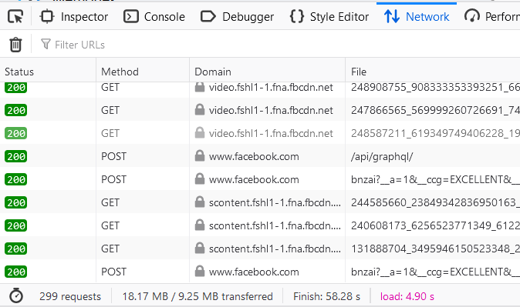
Application Programming Interface
Open any Website > Right Click and select ‘Inspect’ > Go to Networks

Slide 11
Storage of IoT Data
So far, we’ve only Controlled device and Gathered data. We don’t yet have a Perfect IoT System.
We shall now Set Up a system so that you are able to store data indefinite, and for NO COST of a database.
By the end, we will also build a REST API to access data from.

Slide 12
How?
Using Google Sheet to store a Table of Data. We can use the data or view it from anywhere in the world.
Turns out, we can even Create a Graph with that Data.
And Embed that Chart anywhere in our Website.

Slide 13
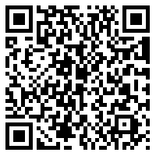
Access all Code (Data Management)
shorturl.at/cgoI7

Slide 14
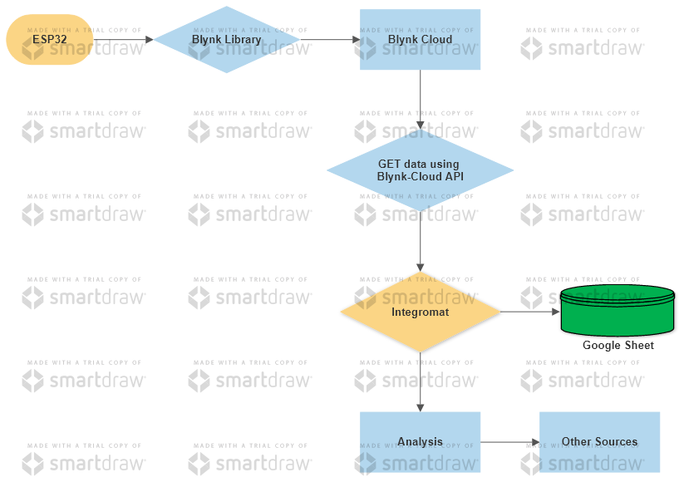
Blynk IoT Data Flow
Google Sheet

Slide 15

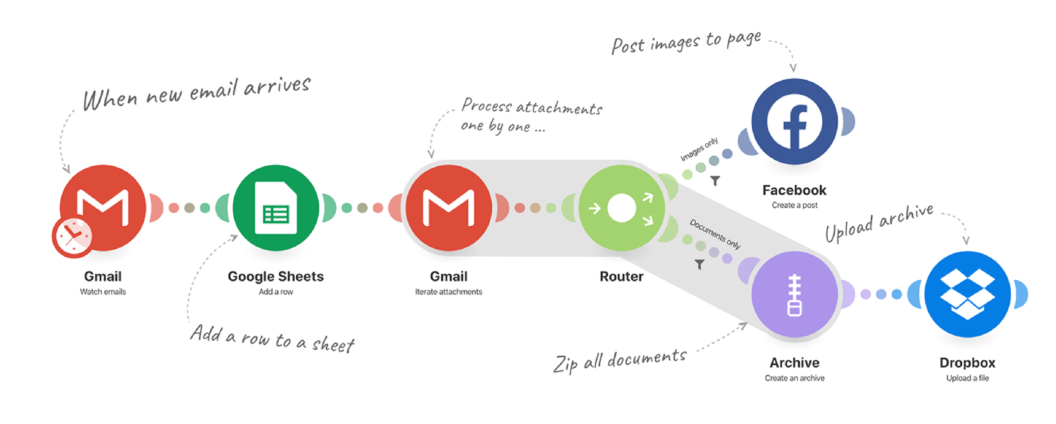
What is ?
A powerful integration platform that allows you to visualize, design and automate your work in minutes.

Slide 16
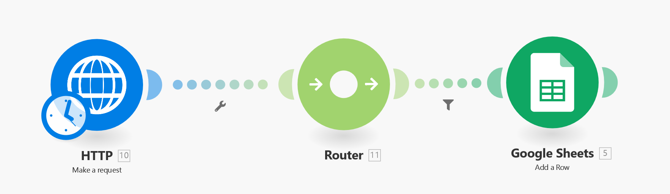
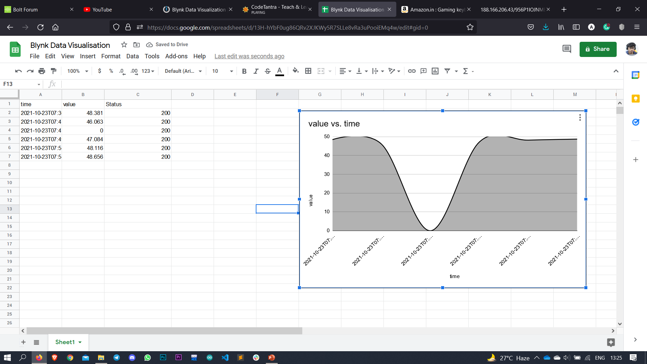
Integromat Configuration (Blynk IoT)

Slide 17
Integromat Configuration (Blynk IoT)
Module Name – HTTP
URL - https://blr1.blynk.cloud/external/api/update?token={token}&{pin}={value}
Method – GET
Body Type – RAW
Content Type – JSON (application/json)
Parse Response –✔

Slide 18
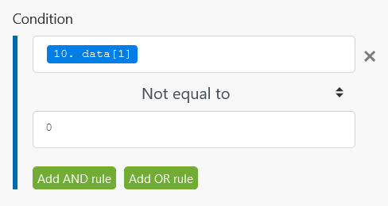
Integromat Configuration (Blynk IoT)
Module Name – Router
Filters Blynk Data before entering Google sheet Module.

Slide 19
Integromat Configuration (Blynk IoT)
3. Module Name – Google Sheet (Add a Row)
Connection – Google Account (Which has the Spreadsheet file created)
Mode – Select spreadsheet and sheet
Spreadsheet - <name of the spreadsheet>
Sheet - <sheet no.> By default, Sheet1.
Table Contains Headers – Yes
Values – time (A) -> now (Date and Time section) value (B) -> Data[] (May not see this option unless Run the Scenario at least once ) status (C) -> Status code

Slide 20
Spreadsheet Configuration (Blynk IoT)
Include the headers, i.e. time, value and status.
Run the scenario to check if new row has been added on the respective headers.
Select the Insert Chart icon: Chart Type – Line/Area/Smooth Line Data Range > Select Data Range > In the Chart, press SHIFT and select ‘A’ and ‘B’. All the rows of A and B will get selected.
X Axis -> Time, Series -> Value
Customize the Chart further.

Slide 21
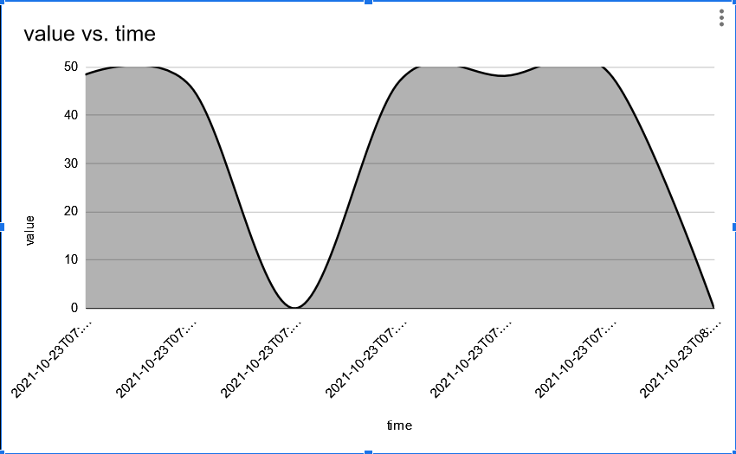
Data Chart (Blynk IoT)

Slide 22
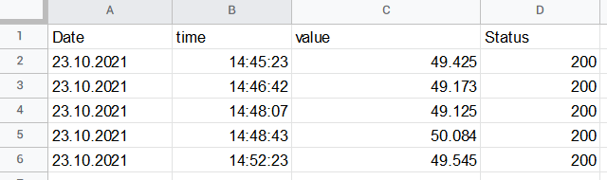
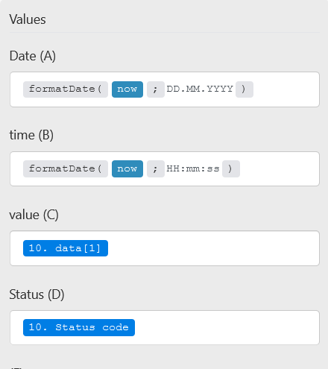
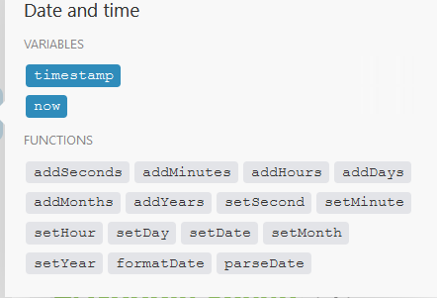
Data Chart (Blynk IoT) - Organized

Slide 23
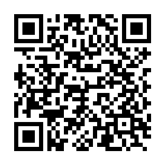
Blynk IoT API Documentation
https://docs.blynk.io/en/blynk.cloud/https-api-overview

Slide 24

Firebase Realtime Database (JSON)
Firebase is a platform to develop Mobile and Web Applications. It provides tools for tracking analytics, reporting and fixing app crashes, creating marketing and product experiment. The Firebase Realtime Database is a cloud-hosted NoSQL database that lets you store and sync data between your users in realtime.

Slide 25
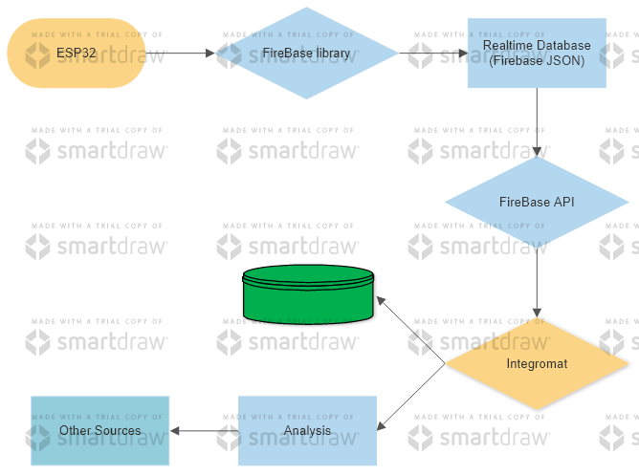
FireBase Data Flow
Google Sheet

Slide 26
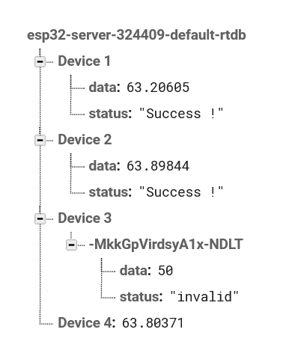
Google FireBase to store IoT Data
Set Up a Realtime Database in Firebase, with appropriate objects
Realtime Database > Create Database > Location (US) > Start in ‘Locked mode’ and Enable (wait for a min. for the setup)
To create objects, Add child (click + ) beside ‘null’ > Enter ‘name’ and ‘value’ > Click ‘Add’
To have a hierarchy, enter ‘name’ and add child (click + beside ‘value’. (As given in the image)
In the ESP32 code, fill the blank spaces with appropriate details.
For Project ID, go to Settings > Projects Settings > General > Get the Project ID.
For Secret Key, go to Project Settings > Service Accounts > Database Secrets > Copy the Secret Key.

Slide 27
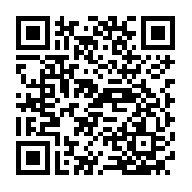
FireBase API Documentation
https://firebase.google.com/docs/reference/rest/database

Slide 28
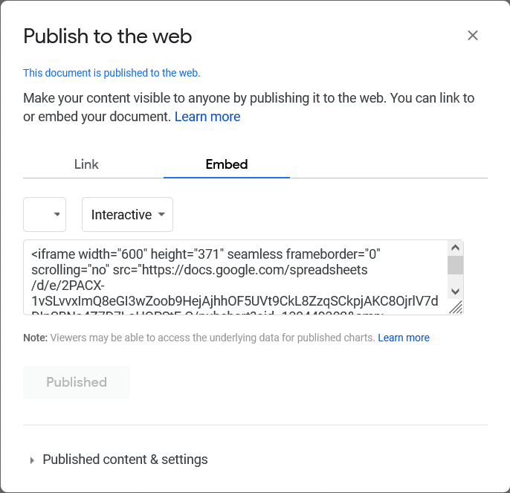
Embedding Chart to any Website
Use the iframe tag to view the chart in your own Website.
How to do that?
Click on the Chart > click ‘three dots’ on top right corner.
Select ‘Publish chart’ > select ‘Embed’ > Click Publish
The iframe tag for the chart will be generated. Which can be used anywhere in the html file of a website.

Slide 29
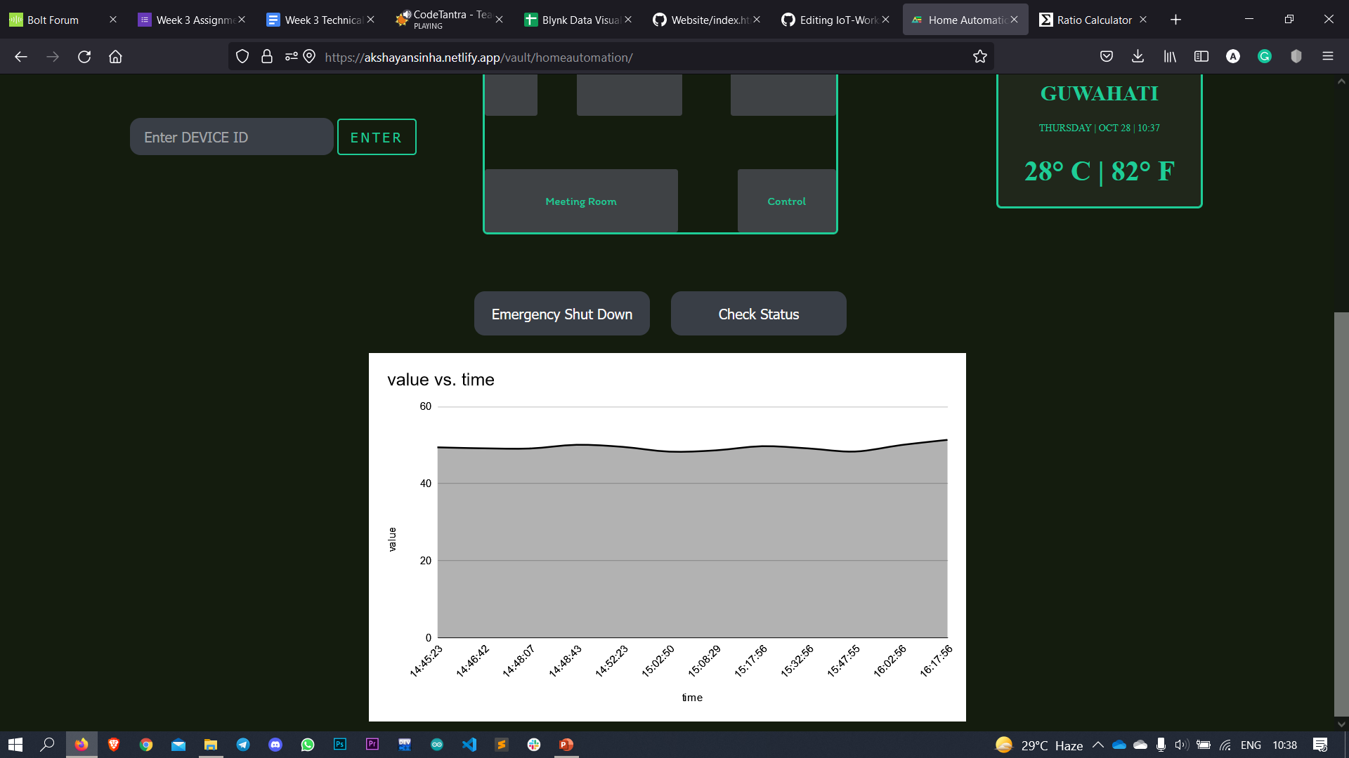
Embedding Chart to any Website

Slide 30
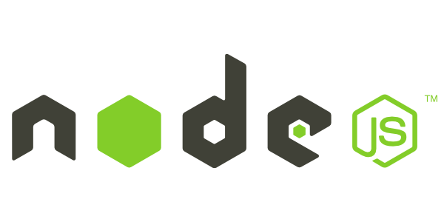


Your own REST – API service
To build a REST API,
NodeJS Application (Server side program)
Using Express framework.
MongoDB (database) to store (optional)
Pre-installations required:
Visual Studio Code (IDE)
Node JS

Slide 31
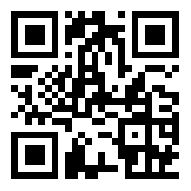
Using Online Template for Overview
https://codesandbox.io/
Create Sandbox > Explore Templates > Search and select ‘node-express-server-rest-api’

Slide 32
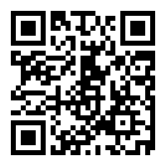
ESP32 REST Server with DB
https://esp32-rest-server.herokuapp.com/

Slide 33
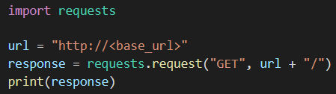
APIs with Python
Like an ESP32, we can Write a Program on Python as well, to send or receive HTTP request to/from any Web Service.
Install requests library, using ‘pip install requests’
Sample Code –

Slide 34
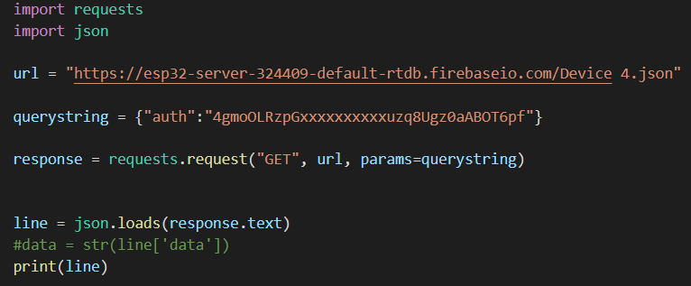
APIs with Python
Install json library, using ‘pip install json’
Sample Code –

Slide 35
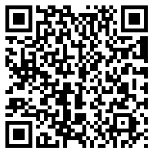
APIs with Python (GitHub Link)
shorturl.at/nvF01

Slide 36
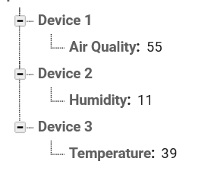
TASK - 3
Use the FireBase API documentation, to get Data from the Realtime Database and Write a Python program to Print Data in a structured format, as shown below - Air Quality -> XX Humidity -> XX %
Temperature -> XX ℃
As a reference, Follow the Structure of FireBase as in the Image.
Insert any int/float value to the Database, do NOT use ’XX’ in the submission.

Slide 37
TASK - 4
Write an ESP32 Program on Arduino IDE, to control an IoT Car
Use the WebServer code from Github as a reference.
Create functions like forward, backward, left and right.
Use proper endpoint on the 4 functions.
Each endpoint must have a heading of it’s Movement.
Go to File > Preferences > Show Verbose output - (Compilation ✔)
Compile and Verify the Code (take screenshot of screen).

Slide 38
TASK - 5
Write a Python code to Send Data to the ThingSpeak or Blynk Cloud
Use the FireBase and City Weather API code as a reference.
Use User input, to get data from the User.
Use that data to Send to Blynk Cloud/ThingSpeak.
(if any) Another Member, use another Python program, to GET that data, use Json Parsing Method to access that.
Use any real-life scenario to Implicate the Program.

Slide 39
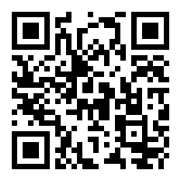
Submission Link
https://forms.gle/zooomBdxnR1YoVsp8

Slide 40





Thank You
Reach me in the below Socials:
LinkedIn -
Hackster -
Instagram -
Github -
Mail -
linkedin.com/in/akshayansinha/
hackster.io/akshayansinha
instagram.com/akshayansinha/
github.com/hippyaki
akshayan.sinha@gmail.com

